Slide 1
Essential Concepts of Redux

Slide 2
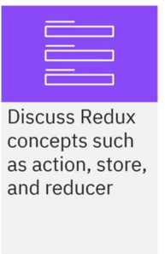
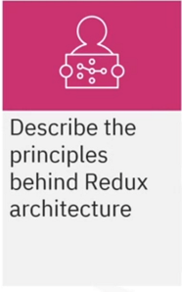
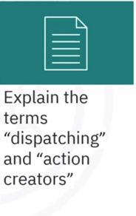
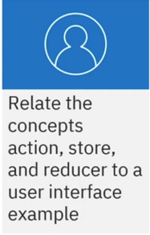
What you will learn

Slide 3



Why Redux

Slide 4
Redux elements
Store:
ALL current states in the app
Action:
Object that indicates state change intent
Reducer:
Specifies how to change the state

Slide 5



Shopping cart example

Slide 6



Shopping cart example

Slide 7

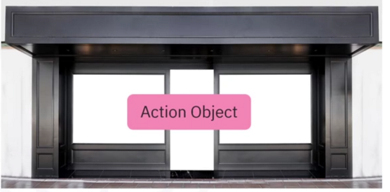
Dispatching
Action creator:
add Item ( ) function

Slide 8



Store

Slide 9
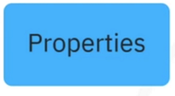

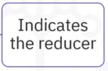


Action object properties

Slide 10
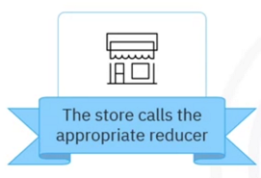
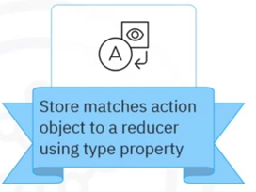
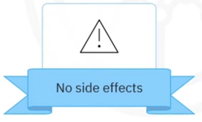
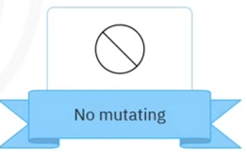
Reducer

Slide 11
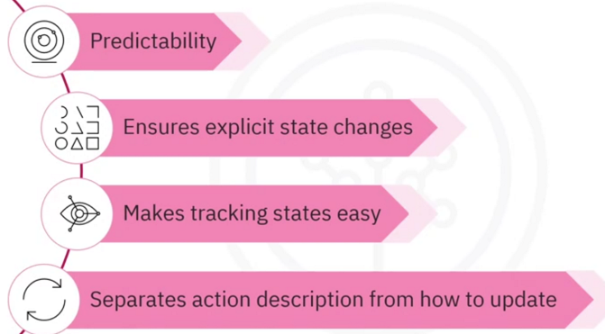
Why this architecture

Slide 12
Recap
In this video, you learned that:
• The action object describes the action that needs to be
performed
• The store maintains all of the application’s current states
• A reducer teds the store how to change the state
• The dispatching action process entails using an action creator
function, which returns the action object and sends the object
to the store using a dispatch function
• The Redux architecture makes states predictable because
changes are explicit through actions, reducers, and the
application store

